Slide 1

Tablet Programme:
Ensuring Success with Integration of eLearning

Slide 2
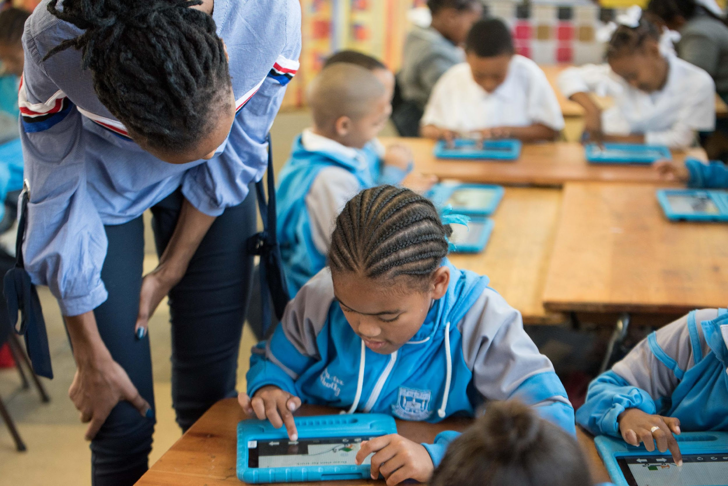
Welcome and Introductions
Presenter Name:
Notes:
Icebreaker- Ask participants to make a line in the middle of the room, ask yes or no questions to assess previous knowledge and the move to left or right based on their answers (can also do it in a smaller space with stand up/sit down) Possible questions:
Have you been teaching for more than 5 years? 10 years? 20 years?
Did you use a smartphone today to communicate?
Did you use technology today (phone, tablet or computer) to access information?
Will you use technology today to do one aspect of your job?
Will you use technology today to complete a personal task outside of work hours?
Do you find using technology to be difficult at times?
Do you wish you knew more about technology or had more time to learn about technology?
*This activity is something that teachers can do at the beginning of the year or term to get to know students, but it can also be done at the beginning of a theme of work to assess prior knowledge

Slide 3

Technology Integration:
The use of technology devices and software as a tool to enhance and support learning
Notes:
Integration happens when technology is used to accomplish a goal or complete a task. For example, when we use google maps on our phone to find location of the training workshop, we are using technology as a tool to accomplish the task of getting to a work obligation. We could use a paper map or drive around and ask people for directions, but using google maps to arrive at the location on time has enhanced our life and supported our task. (Use another example that came up during the icebreaker)

Slide 4
Why is technology integration important?
Digital divide
COVID has caused a widening of the gap
Notes:
Why is integration important? The world is moving on and if we don’t embrace technology integration, we are left behind. The economy, society, and culture depends on it. Describe the digital divide- a gap growing between people that have access to technology/connectivity and those that don’t.
Give stats on changes in education since COVID 2020. https://www.statssa.gov.za/?p=15197

Slide 5
“[During COVID closures], only 11,7% of schools offered remote learning options nationally…the urban-rural divide was prominent, as twice as many individuals were given the option of remote learning in urban areas compared to rural areas.”
South Africa Dept of Statistics “How COVID-19 changed the way we learn”
Notes:
Give stats on changes in education since COVID 2020. https://www.statssa.gov.za/?p=15197
Discuss why this is important to note.

Slide 6
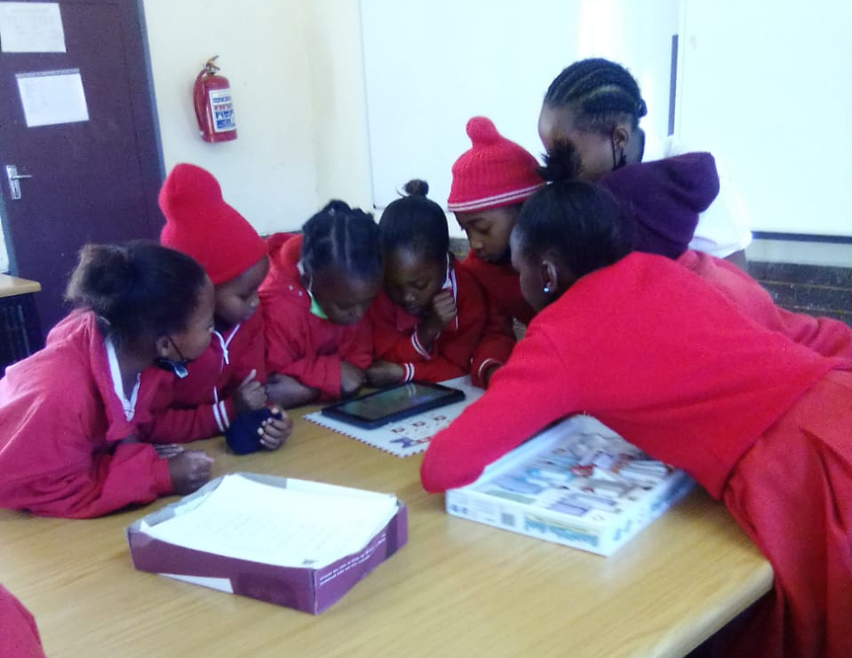
21st Century Skills:
• Collaboration
• Communication
• Creativity
• Critical Thinking
• Character
• Citizenship
• Computational Thinking
Notes:
We don’t know what lies ahead and therefore we cannot just teach technology content. Think back to our education experience. What tech classes did we have and are those learning still relevant. We have to teach skills for our learners to be able to be able to cope with a changing world since we cannot predict what they will need.

Slide 7
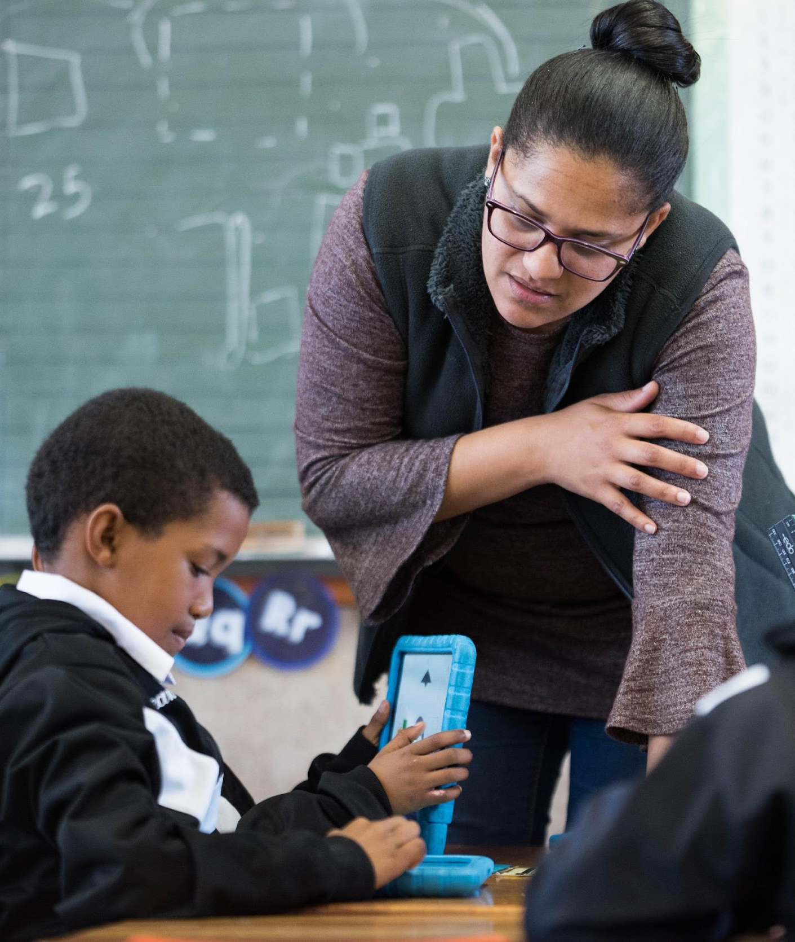
What technology integration is not:
Not a replacement for a teacher
Not ‘free time’ for the learners or teacher
Not a replacement for a quality lesson plan
Not a separate class or additional curriculum
Notes:
Discuss what other misconceptions there are about the use of technology in learning.
The main idea is that TECH.NOLOGY IS A TOOL TO ENHANCE AND SUPPORT TEACHING AND LEARNING. True integration is when technology is planned in to the lesson as a tool to teach a skill and meet a clear objective.

Slide 8
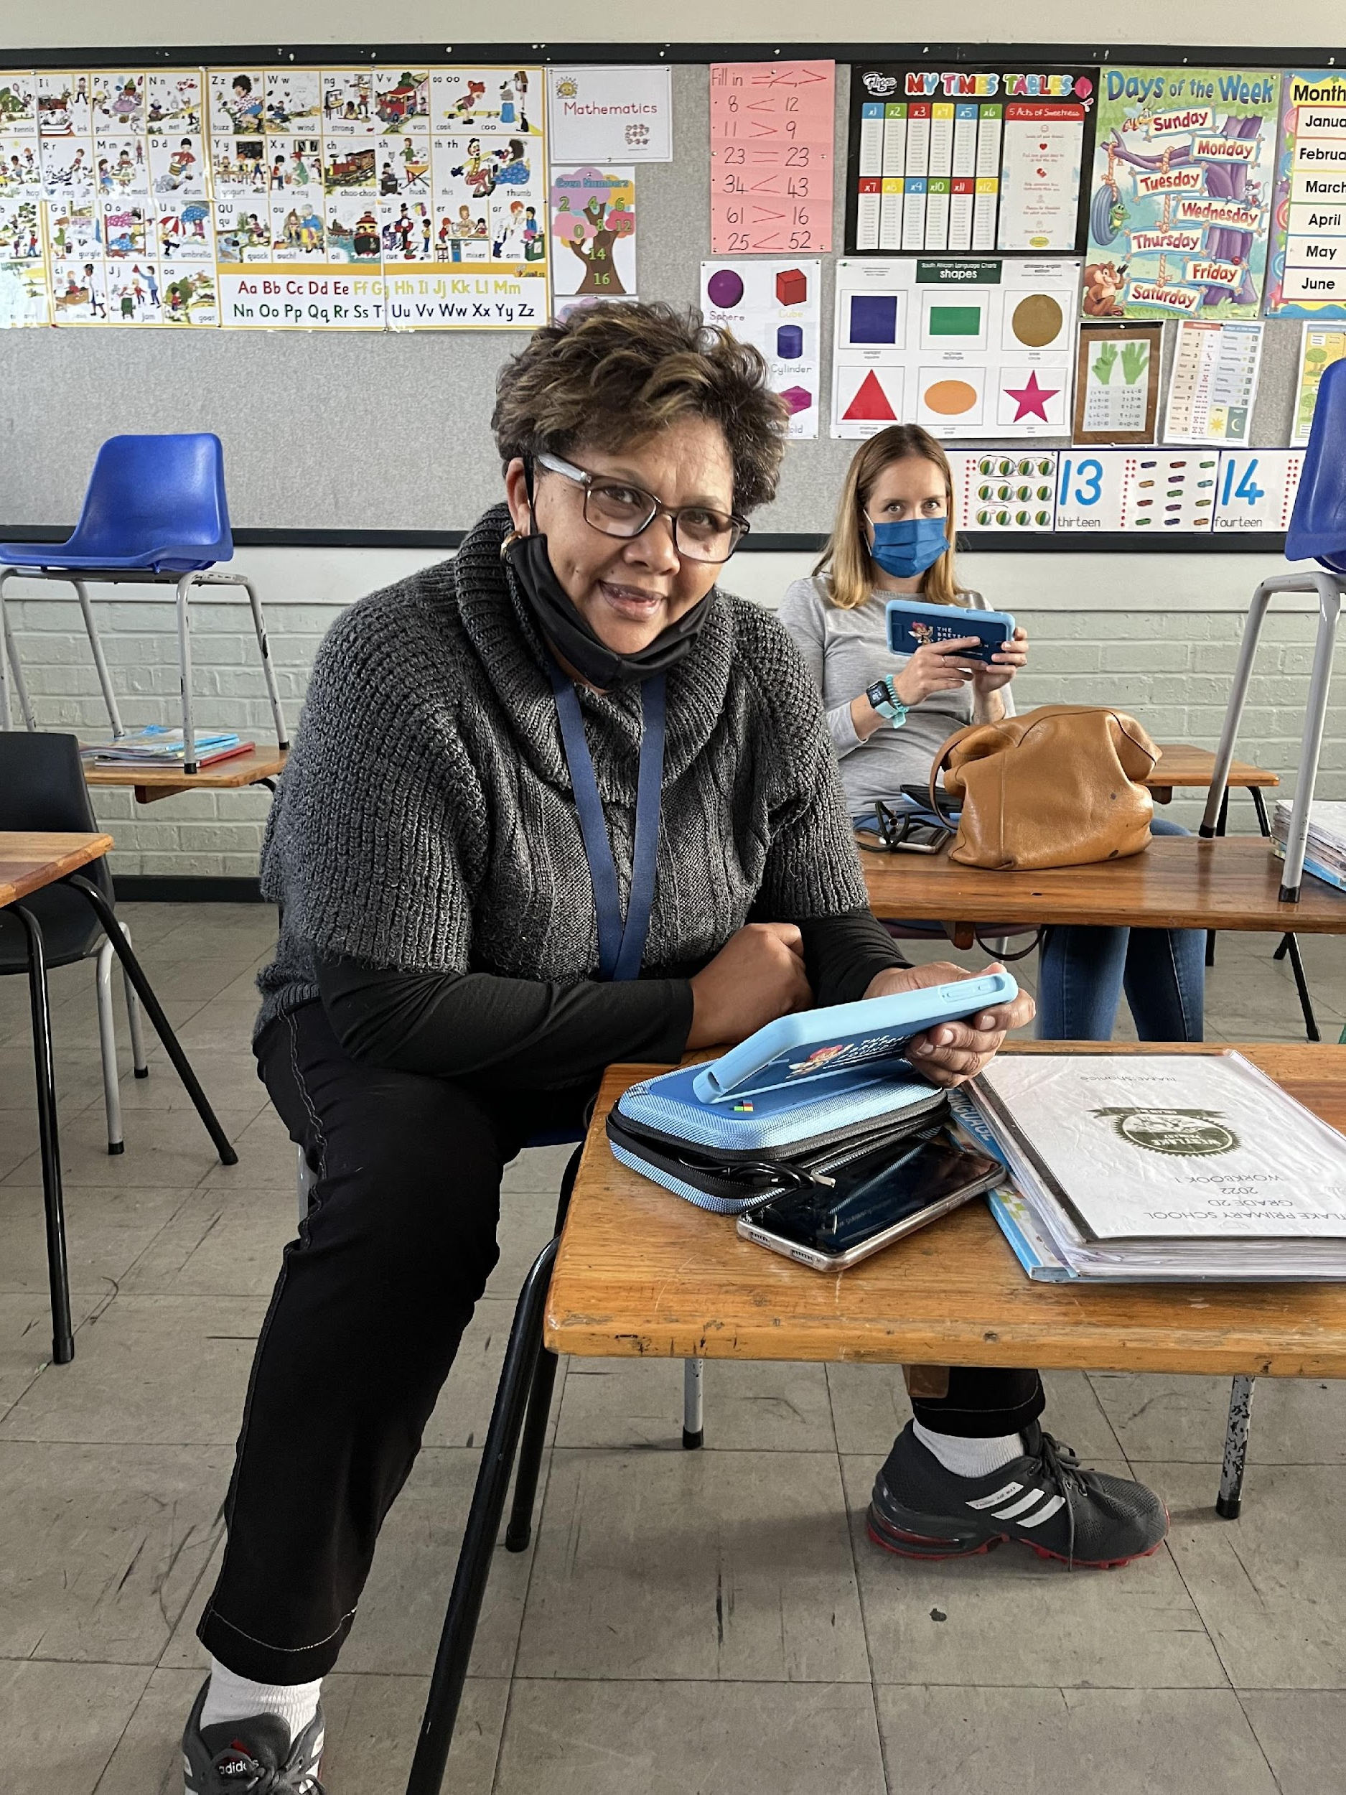
EXPLORATION OF
CURRICULUM-LINKED SOFTWARE
Notes:
Participants will break up into groups of 3-4 and explore the tablet. They will put themselves in the shoes of the learners and just play. (10 min) Facilitator will walk around and assist, but not help too much. It should be exploratory and fun- Assure them that the tablets are made for children to use and they should feel comfortable to click around without fear of messing it up.

Slide 9
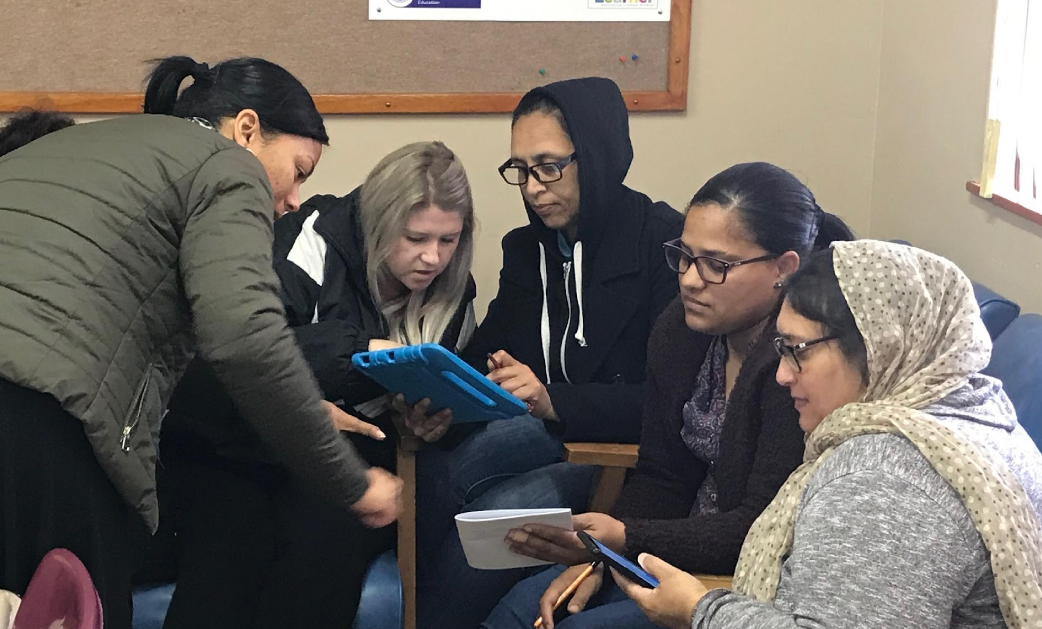
GROUP WORK GUIDING QUESTIONS:
What skills/objectives are being
practiced in this app?
What are the benefits of using this app?
How would you use this app in a lesson?
Notes:
Each group will choose one app that interests them to present on. They will prepare a 2 min presentation about the app answering some of the guiding questions below (10 min):
What skills/objectives are being practiced in this app?
What are the benefits of using this app?
How would you use this app in a lesson?
Each group will briefly present their app to the larger group. (15 min)

Slide 10
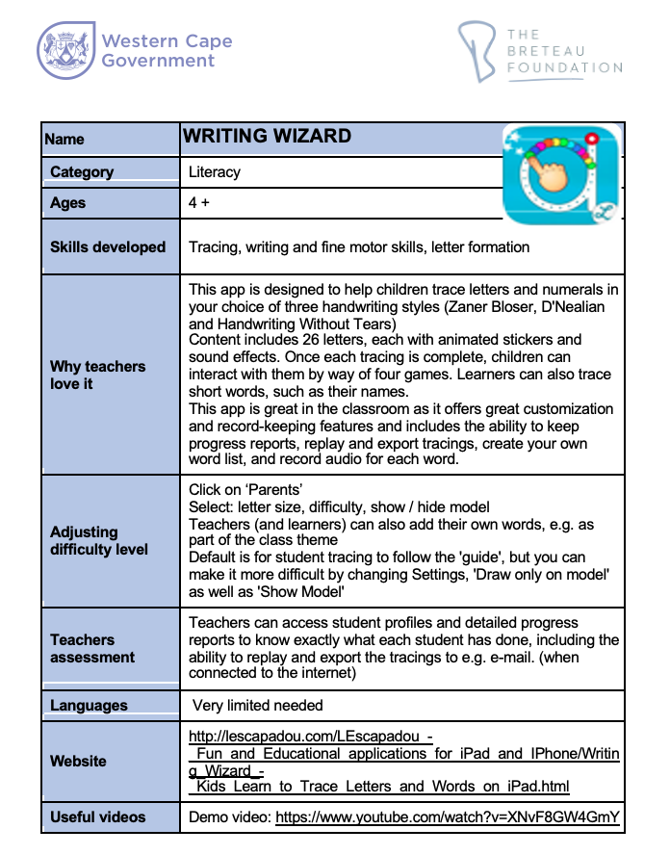
APP GLOSSARY
Notes:
Refer to resource pack and explain curriculum maps and app glossary. (10 min)
Highlight Talking Stories and show participants how to access the programme.

Slide 11
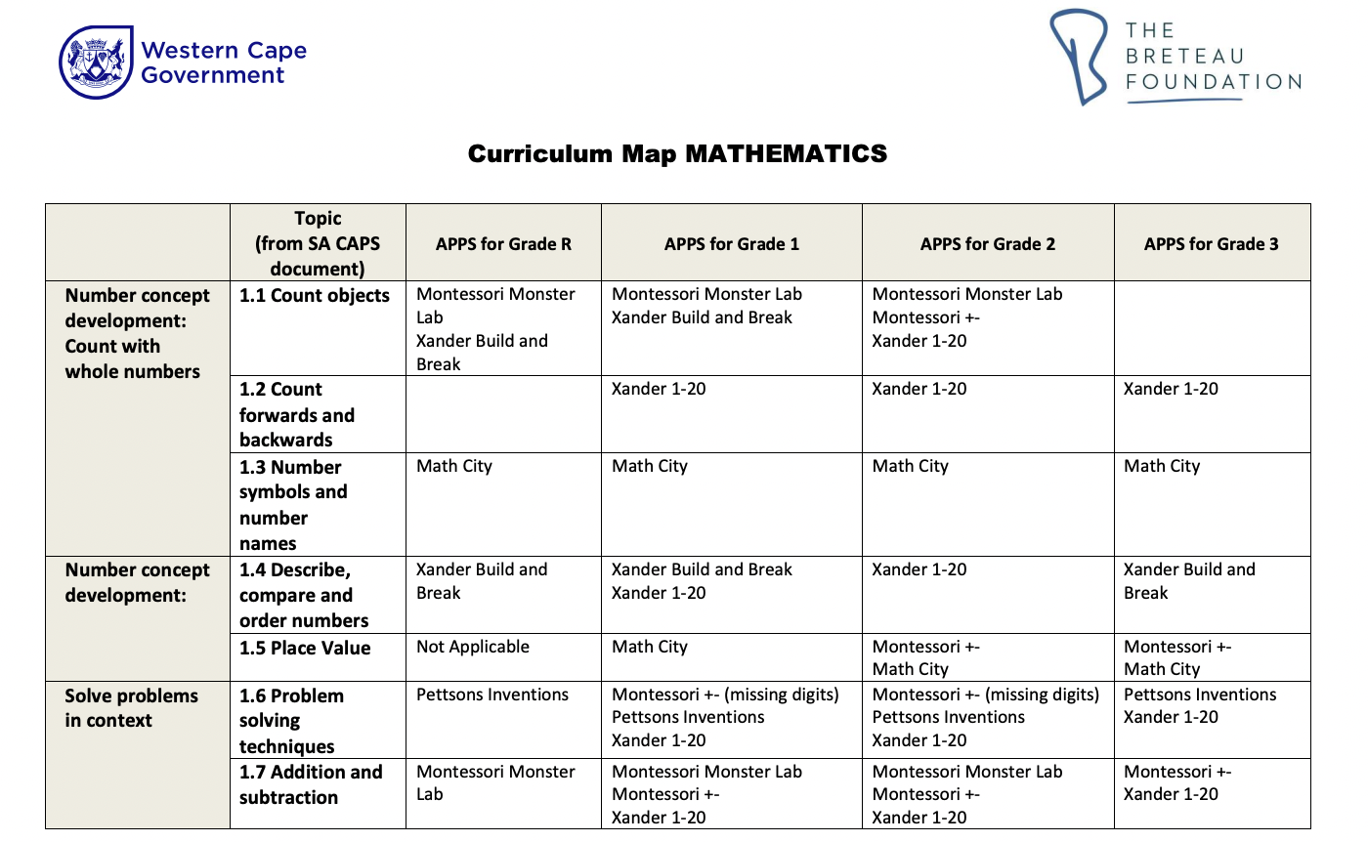
CURRICULUM MAP
Notes:
Refer to resource pack and explain curriculum maps and app glossary. (10 min)

Slide 12
Break

Slide 13
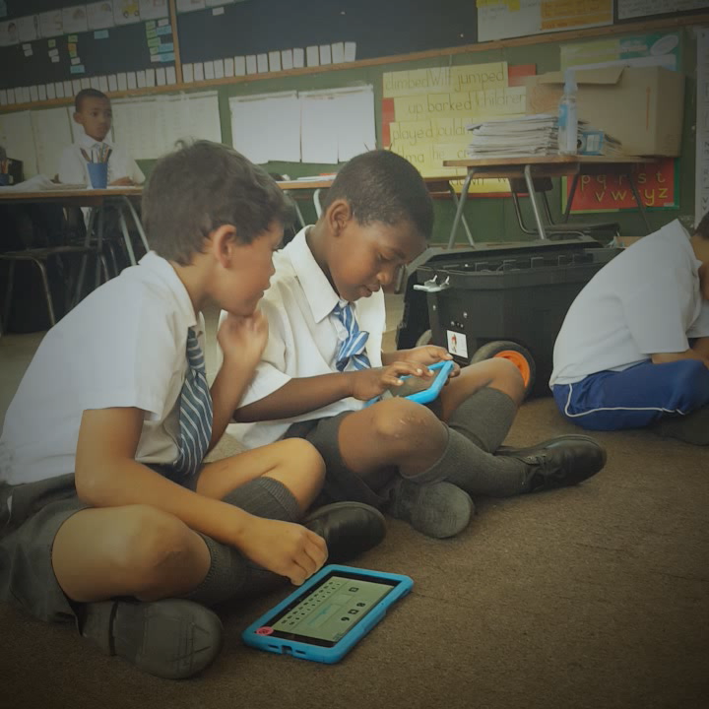
Creating a Differentiated Classroom of Work Stations to include Tablets:
Notes:
The goal is to have a group of students working with the teacher, a group of students working independently on a task, and a group of students working on the tablets.

Slide 14
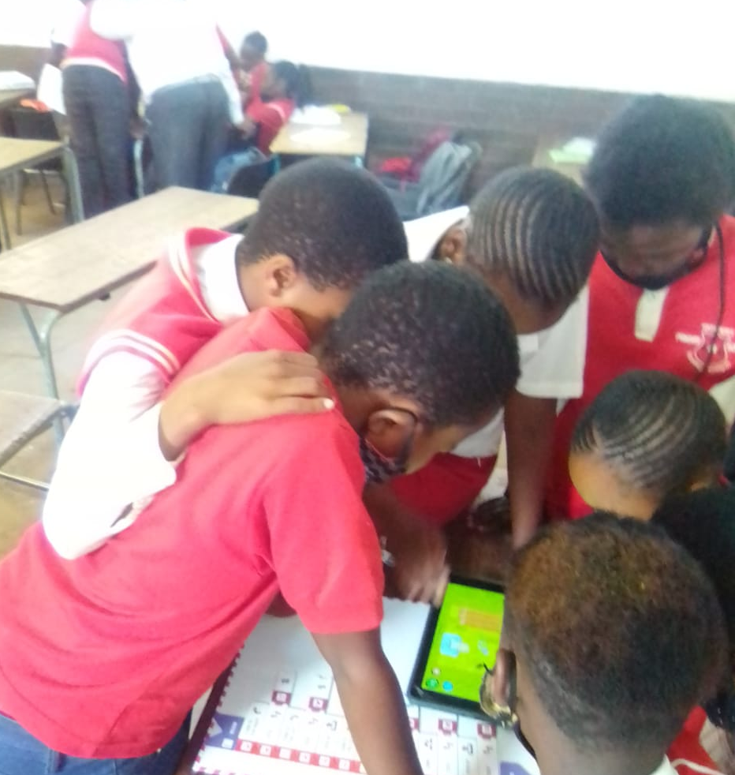
Creating Differentiated Groups based on
Ability Level:
Homogenous groups-
children with similar ability levels
Heterogenous groups-
children with varied ability levels
Notes:
Creating Differentiated groups based on level- Various ways to group children based on level of understanding of skills. Each method has it’s benefits and methods of grouping students can vary depending on the activity,
Homogenous groupings- all the highs together, all the lows together- students can work together on a task that is at their ability level, each group will have assignments with varying levels of difficulty.
Heterogenous (mixed) groups- students from various levels can help each other with a task, each child brings their own strengths to the task, allows children to collaborate with others

Slide 15
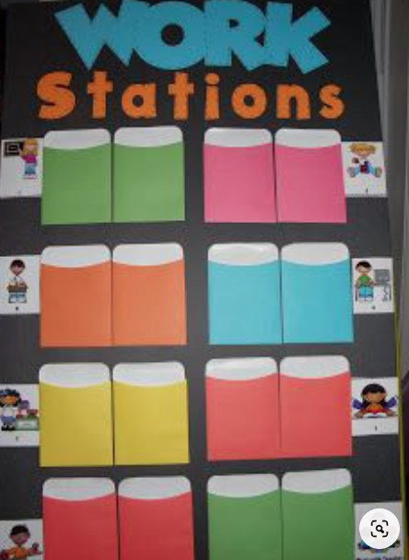
Creating Differentiated Groups based on
Ability Level:
NB: Naming the groups
Changing groups
Notes:
NB- use names (ie. turtle group, sharks) or colours to name groups so the students do not know how the groups were made
Change groups from time to time to ensure students get to work with other students, also allow for movement from group to group depending on ability growth (monthly, termly, etc)

Slide 16
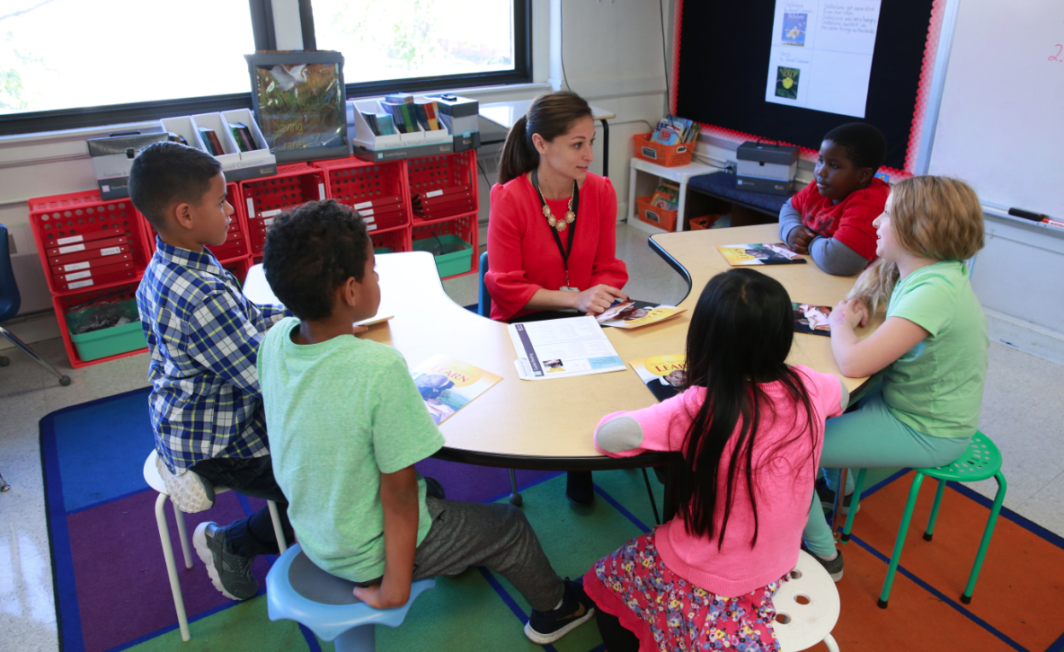
Teacher Station:
New content
Assess previous learning
Remediate unmastered skills
VALUABLE TIME!
Notes:
The teacher station: a small group of learners sits with the teacher for this station. It can be used to teach new material, assess learning that has already taken place, or to remediate unmastered skills. This is valuable time that the teacher can get to know the strengths and weaknesses of individuals in a small group.

Slide 17

Independent Learner
Station:
Clearly outlined task
On learners’ level
Without teacher intervention or
support
Accountability
Notes:
Independent learner stations: a small group of learners works together or individually to complete a clearly outlined task without teacher intervention/support.
After the station is finished, there needs to be a level of accountability for students to show their work completed during independent time

Slide 18
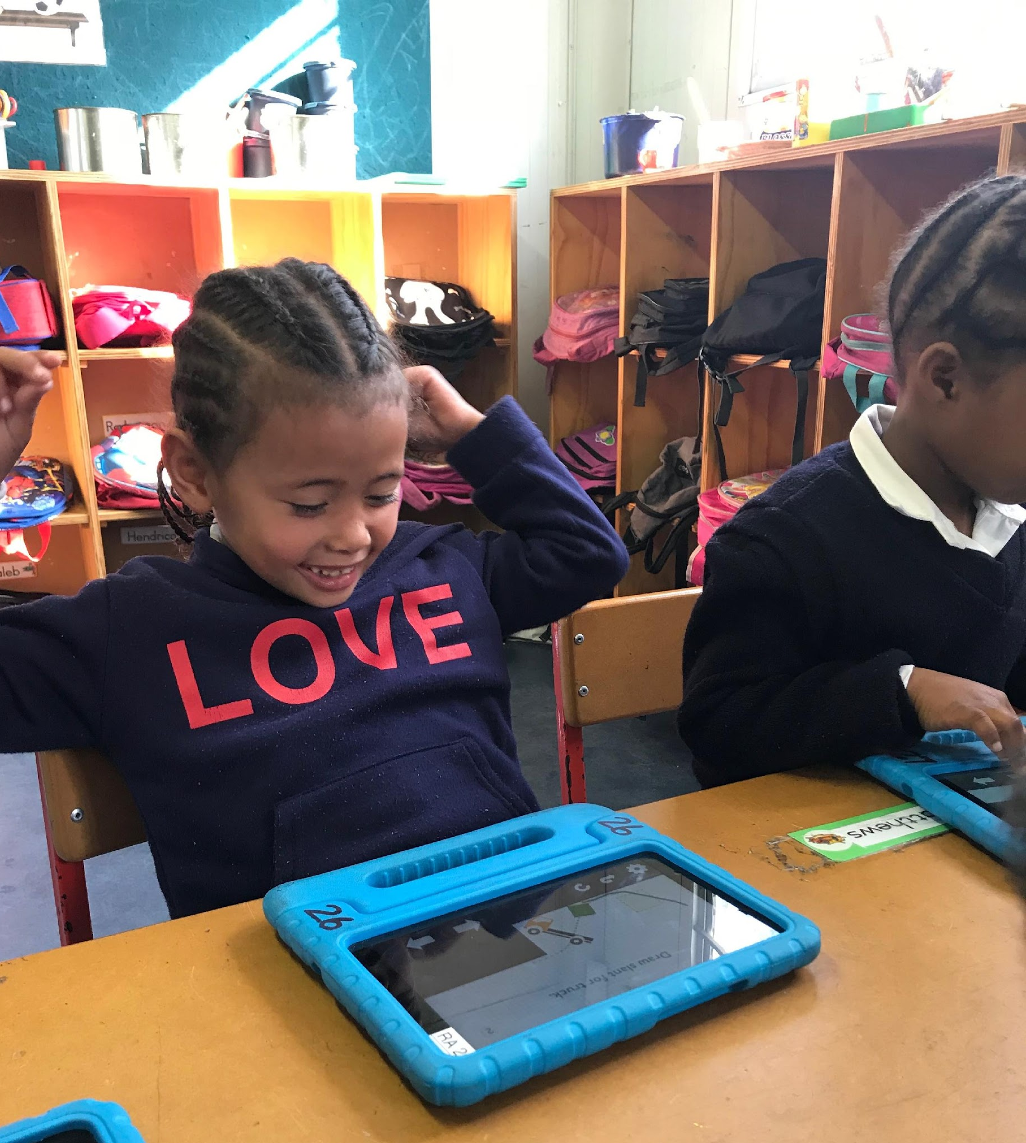
Tablet Station:
Linked to curriculum objectives
Tablet rules essential
Notes:
Tablet station: a small group of learners works individually on tablets on a specific app that is linked to the curriculum objectives of the lesson, tablet rules are understood and enforced (from afar) during this time.

Slide 19
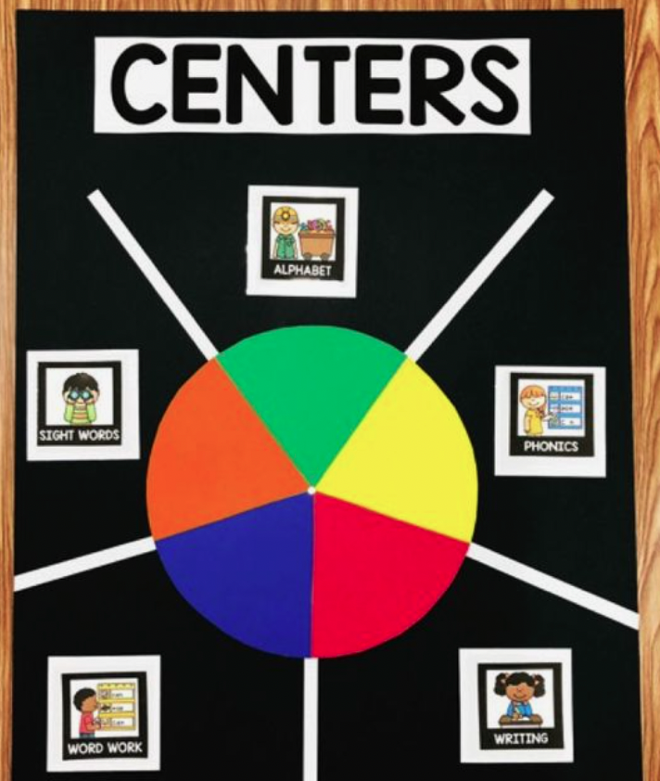
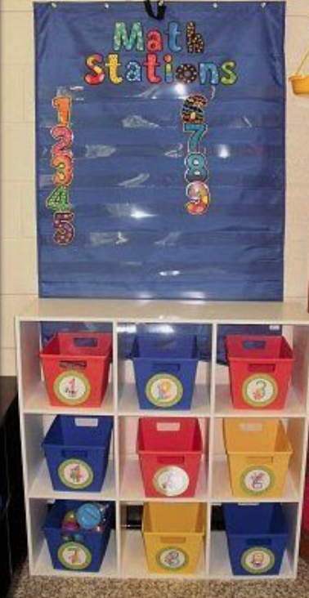
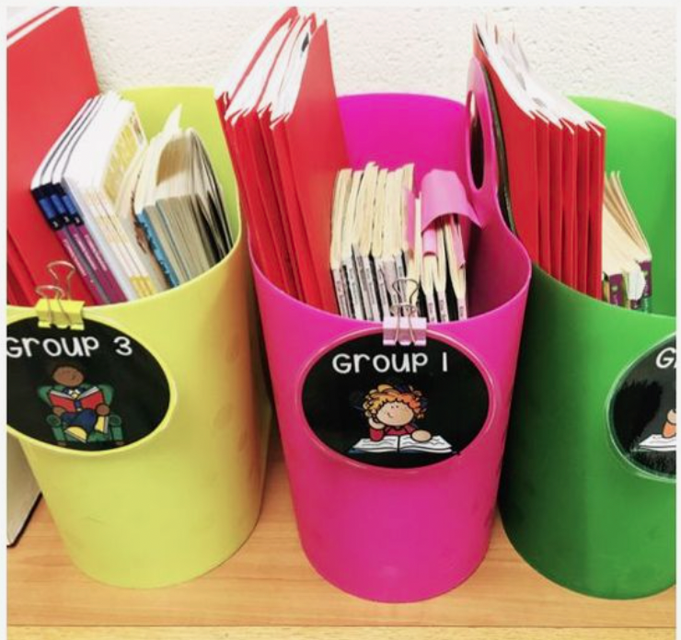
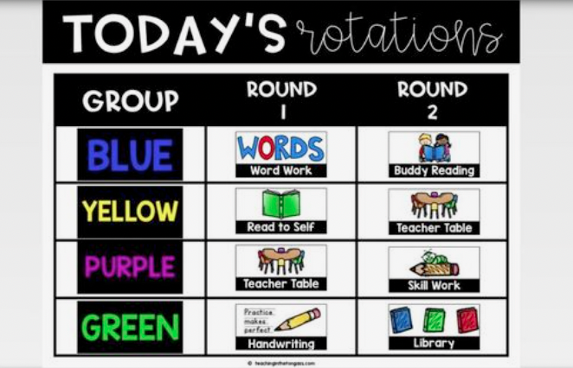
Learning Stations:
Space
Organised
Timer
Learner behaviour and voice levels
Rotations
Practice, practice, practice
Notes:
Additional tips and tricks for smooth transitions and effective independent work during stations
If classroom space does not allow for spreading out, learners can sit at desks in groups for all stations.
Baskets of materials ready with copies and clear instructions ready at the start
Timer used for stations and transitions (ie. You’ll have 15 min to work at this station. And then we’ll have 2 min to clean up the station for the next group)
Set clear expectations of student behavior and voice levels (silent or soft talking for group work) and reinforce positive and negative behavior with a behavior chart
Rotations to the next station are simultaneous and calm.
Practice practice practice.

Slide 20
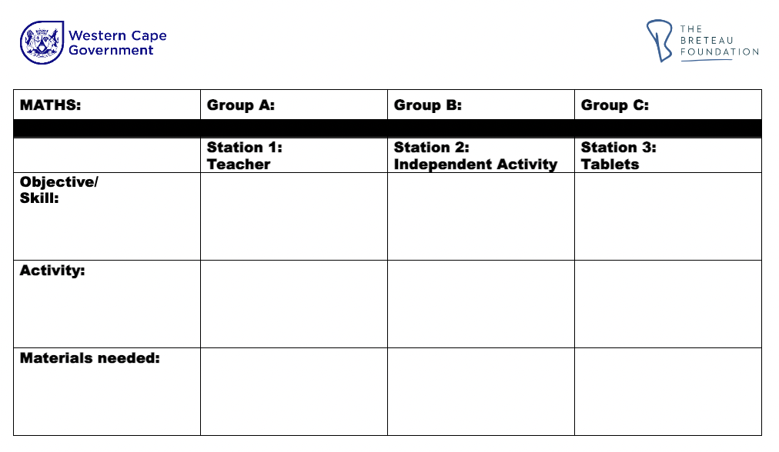
PLANNING
Notes:
Weekly lesson plan template. How to take a set of objectives and differentiate it for three groups. Each week can include the teaching of skills, practice of skills and assessment of skills.
Show the weekly lesson plan template and one that has been filled in. Explain how each station has an objective and a clearly outlined activity.

Slide 21
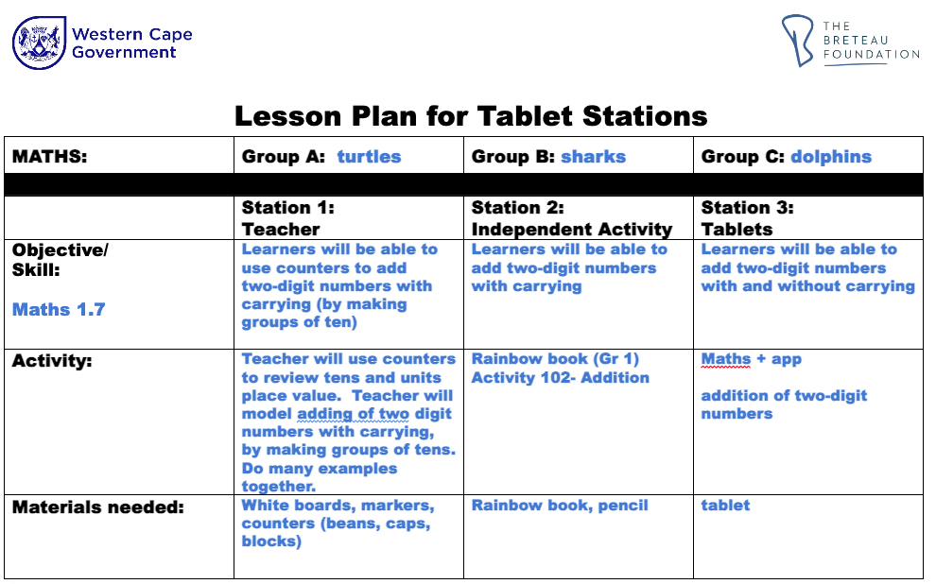
PLANNING
Notes:
Weekly lesson plan template. How to take a set of objectives and differentiate it for three groups. Each week can include the teaching of skills, practice of skills and assessment of skills.
Show the weekly lesson plan template and one that has been filled in. Explain how each station has an objective and a clearly outlined activity.

Slide 22
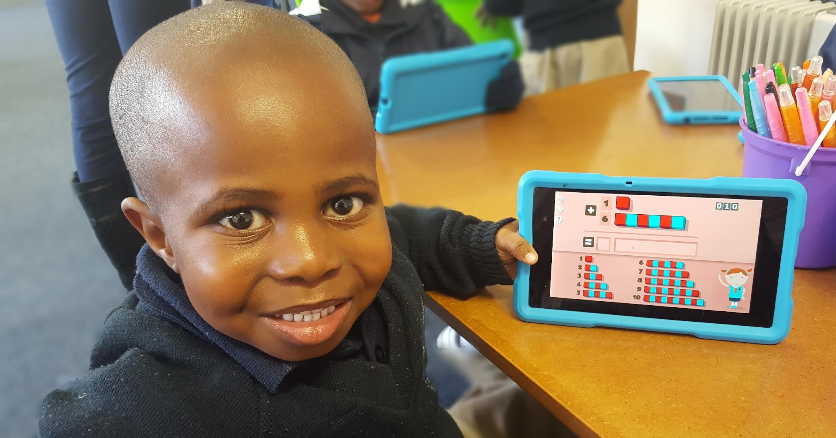

Collecting feedback from Offline Tablets:
Student points
Write in book alongside
Informal questioning
Notes:
Collecting feedback from offline tablets- Because tablets are offline, there is no way to electronically assess students’ understanding. But there are informal ways to collect information about individual student mastery.
Look for apps where students earn points or stars for correct completion of tasks
Students can write in a book alongside the tablet to keep a record of their work
Teacher can ask questions after the station to assess student understanding or have students anonymously self-assess their understanding (“On a scale of 0-5, how do you feel about adding two digit numbers?)

Slide 23
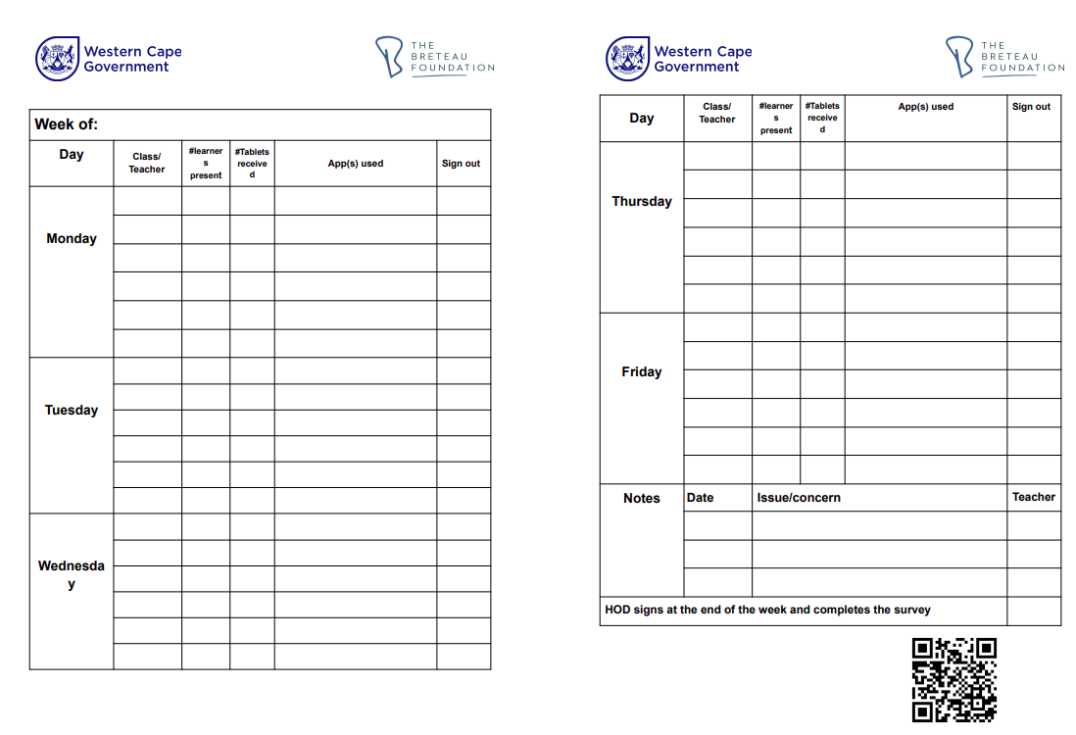
Collecting feedback from Teachers:
Logbook
Notes:
Tablet usage Log Book- explain how it works and what is being documented, Explain how the Google Form works.

Slide 24
Operations and Logistics:
Pedagogy and Technical Guide
Notes:
Show pedagogical and technical guide. Give participants 10 min to look through pages and familiarize themselves.
Highlight key areas of guide:
Rotation timetable
Charging
Safety and security

Slide 25
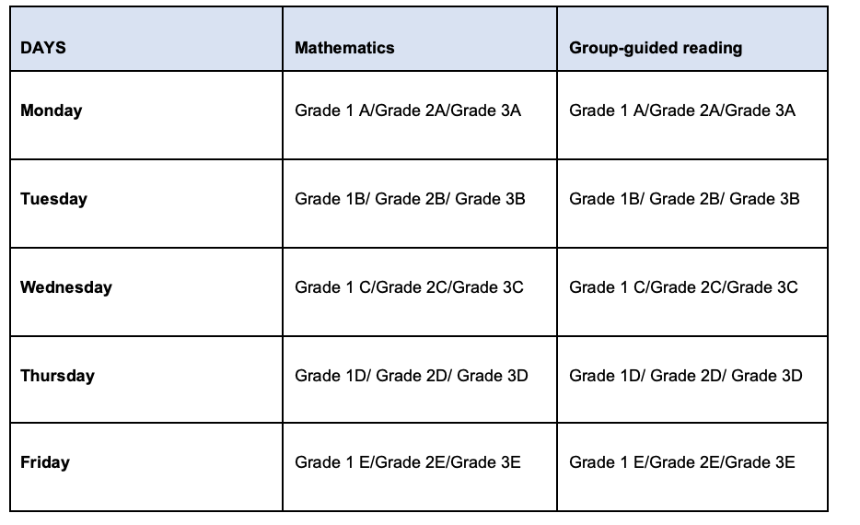
Operations and Logistics:
Rotational Timetable (sample)
Notes:
Show pedagogical and technical guide. Give participants 10 min to look through pages and familiarize themselves.
Highlight key areas of guide:
Rotation timetable
Charging
Safety and security

Slide 26

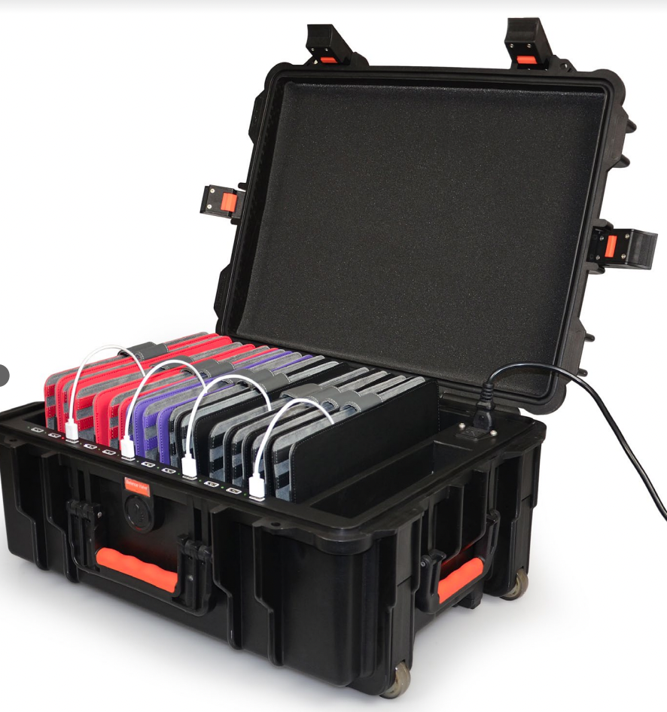
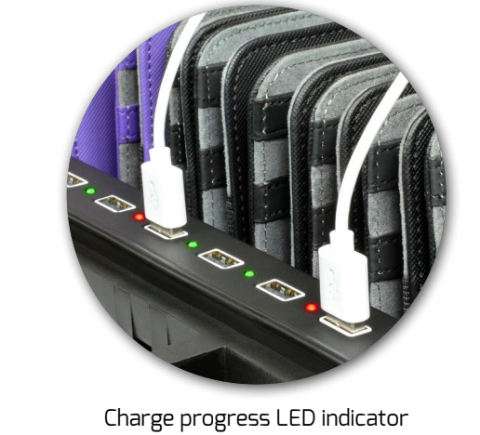
Operations and Logistics:
Charging
Safety and Security
Notes:
Show pedagogical and technical guide. Give participants 10 min to look through pages and familiarize themselves.
Highlight key areas of guide:
Rotation timetable
Charging
Safety and security

Slide 27
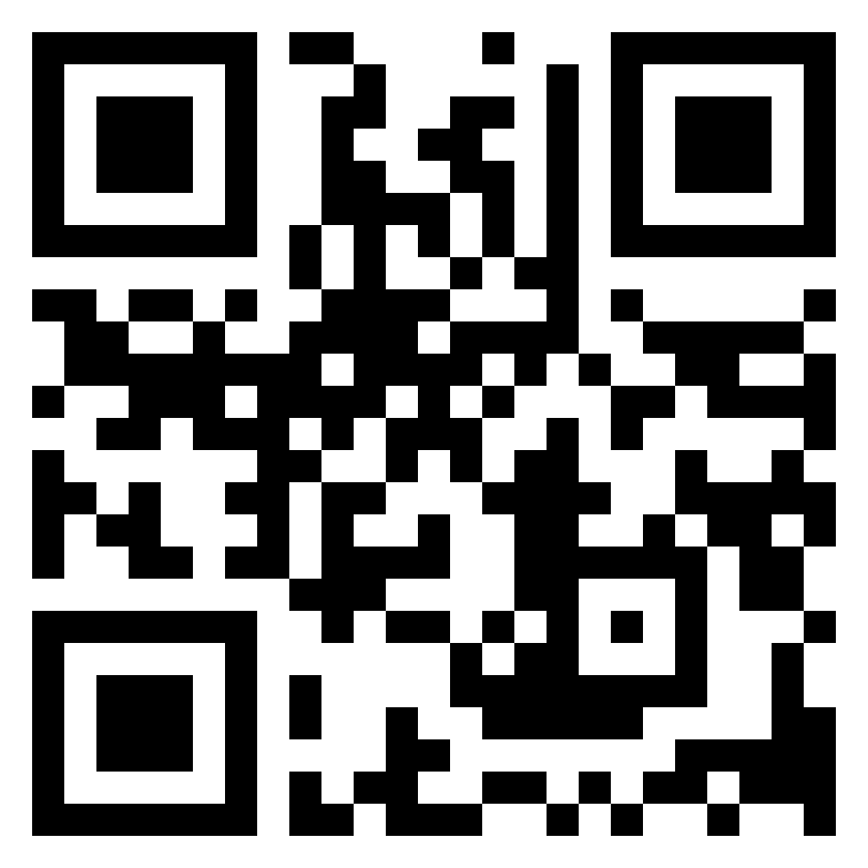
Please sign the register by using this QR code or going to
tinyurl.com/WCEDtablets
Thank you.
Presenter contact information:
Notes:
The URL is case sensitive

